Slide 1
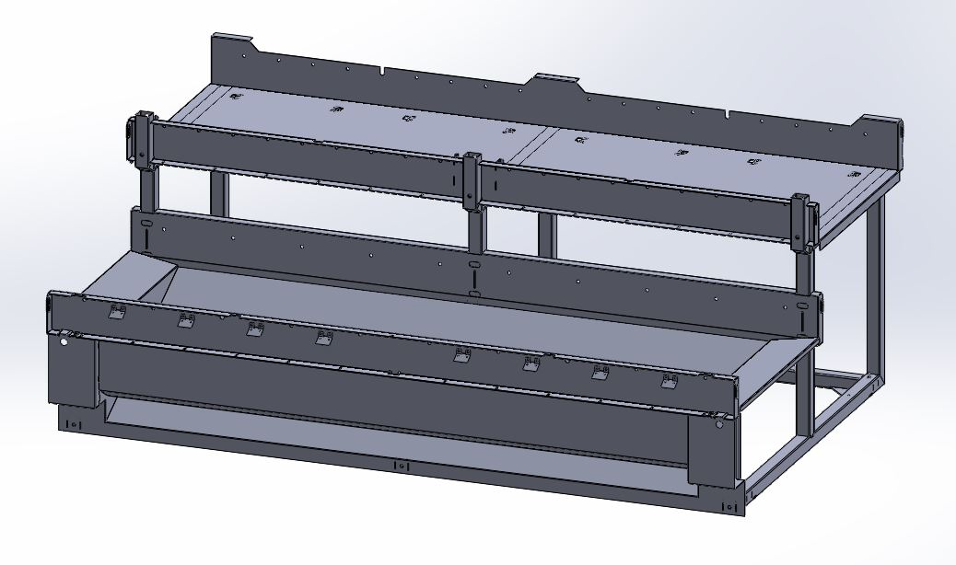
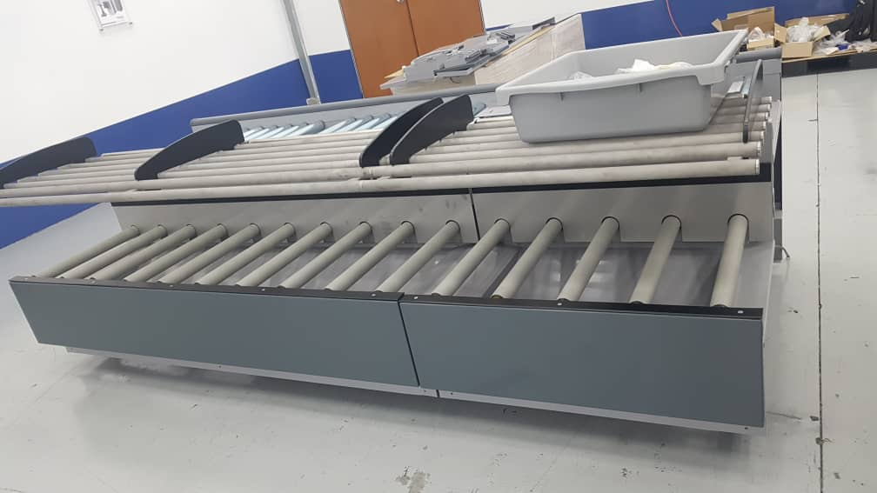
Herbert TRS (Tray Return System)
Solidworks 3D Design
Actual part fabrication with assembly
Solidworks 2D Design

