Slide 1
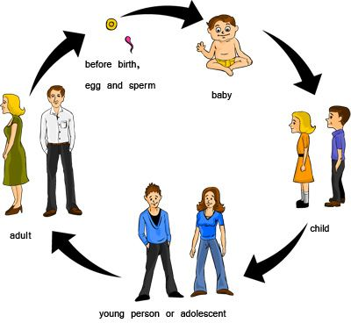
Life of human
Thinking sharp

Slide 2
How human being spend his life?
OPEN EYES
CHILDHOOD
TEEN AGE
JOB?
MARRIED
1.OPEN EYES FIRST TIME
2.ENJOY HIS CHILDHOOD
3.DO MISTAKE IN HIS TEEN AGE
4.FIND JOB
5.FINALLY MARRIED

Slide 3
Interesting facts
Most population exist in which part of world ?
China is the most populated country in this world
It’s population 1,439,323,776 it is the first largest country
In the world

