Slide 1
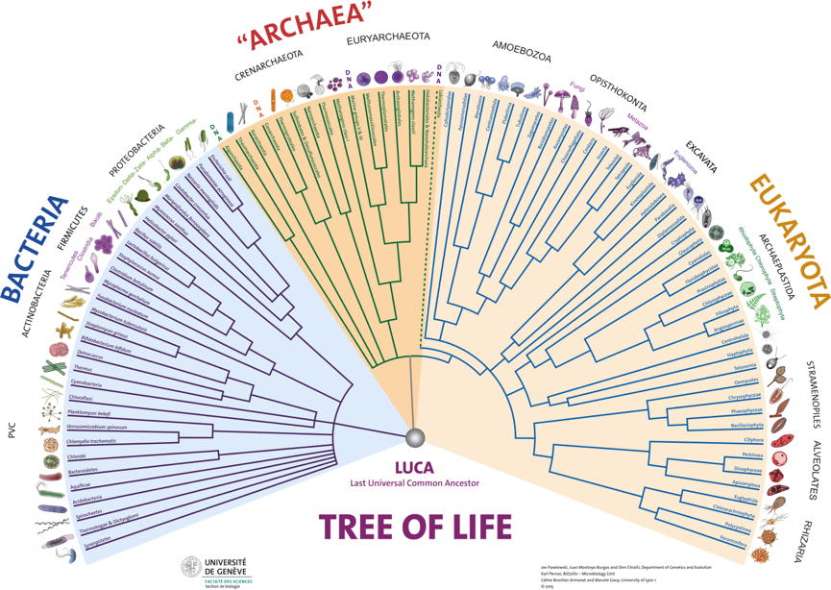
Ultrametric and Additive Tree

Slide 2
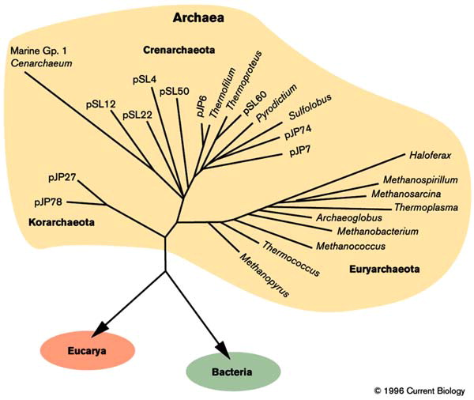
Contents
Phylogenetic Tree
Why build evolutionary tree?
Types of Tree
Ultrametric Tree
Additive Tree
Software to Create Additive and ultrametric Tree
Ultrametric And Additive Distance
Ultrametric And Additive Matrix

Slide 3
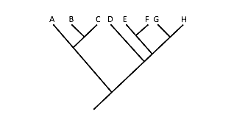
Phylogenetic Tree
Shows inferred evolutionary relationships.
Based upon similarities and differences in their
physical
or genetic characteristics
Most common ancestor of the descendants.
History: Edward in 1840
Charles Darwin in 1859

Slide 4
Phylogenetic Tree

Slide 5
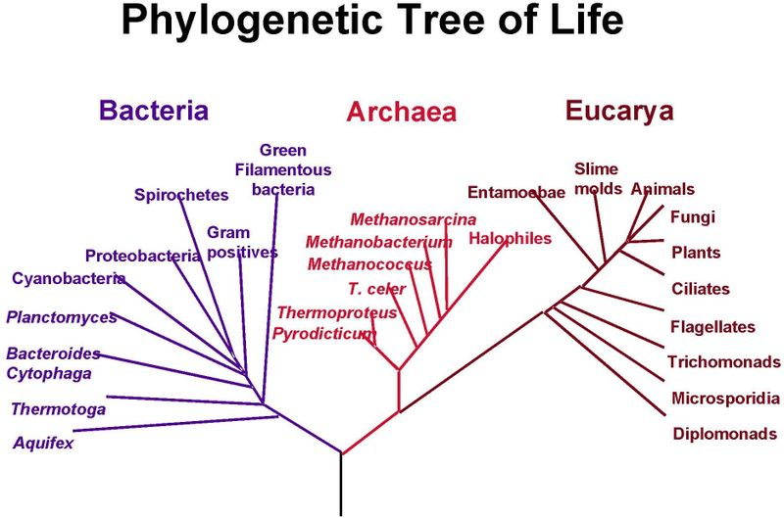
Why build evolutionary tree?
Understand the lineage.
Organizing principle.
Understand how functions evolved.
Understand forces and constraints.
For multiple alignment.

Slide 6
Types of trees
Ultrametric
Additive
Distance based
Maximum parsimony
Maximum likelihood
Character based
Constructed using distances between species.
Constructed based on the acquisition.
Distance-matrix methods may produce either rooted or unrooted trees.
Use the aligned sequences directly during tree inference.

Slide 7
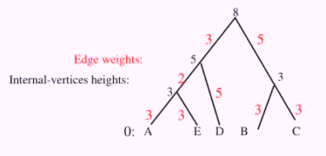
Ultrametric Tree
A rooted tree with edge lengths.
Represent the molecular clock .
Basic property:
The height of the leaves to be 0.
Edge weights represented by heights of internal vertices.

Slide 8
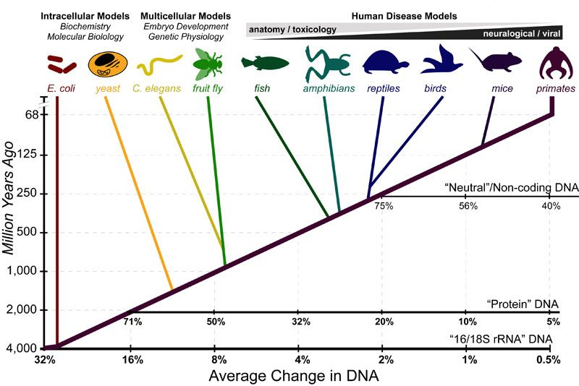
Ultrametric Assumptions
Molecular Clock Hypothesis
Accepted point mutations in sequence occurs at constant rate.
– Varies from protein to protein.
Can be used to depict evolutionary time.
Number of accepted mutations is proportional to length.

Slide 9
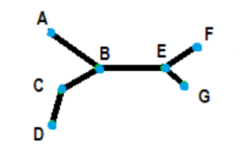
Additive Tree
Represent clusters of data in a graph.
Used when data table is composed of rows and columns.
Node B is connected by one path to node E.
Node E is connected by one path to node F.
The distance is graphically represented by the distance.

Slide 10
Purpose of Additive tree
Used to represent tree.
Observed similarity is represented by a tree-distance d.
Representations useful in wide variety of domains, for example,
illation of manuscripts,
psychological similarity between animal terms
phylogenetic trees.

Slide 11
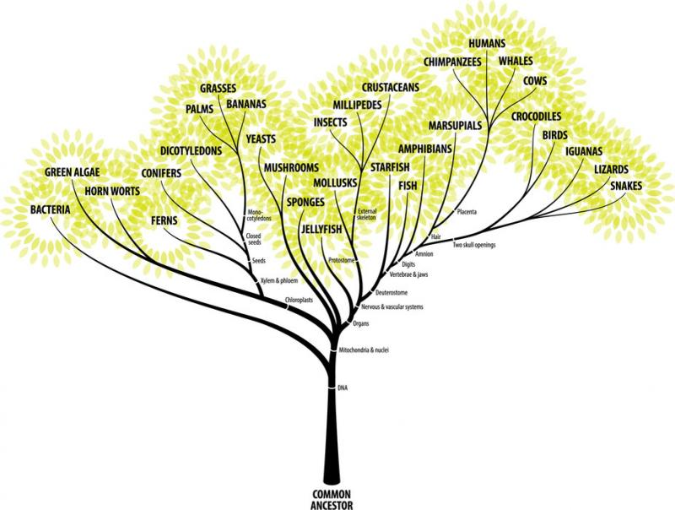
Software that can Create Additive and ultrametric Tree
The Matlab command is [addtree.m) and displaying them is [displaytree.m].
The SAS command for creating an additive tree is TREE.
The most commonly used programs for getting an ultrametric tree are
i- BEAST,
ii- DPPDIV
iii- r8s.
Notes:
Many statistics software programs can produce additive And Ultrametric Tree. For example:

Slide 12
Notes:
Figure 5. A phylogeny and the three basic kinds of tree used to depict that phylogeny. The
cladogram represents relative recency of common ancestry; the additive tree depicts the amount
of evolutionary change that has occurred along the different branches, and the ultrametric tree
depicts times of divergence

Slide 13
Additive Tree Distance
Additive Tree
“The distance between any pair of leaves (i, j) is the sum of the distances between the leaves and the first node k that they share in the tree.”

Slide 14
Ultrametric tree distance
Ultrametric tree :
If the distances between any two leaves i and j, and their common ancestor k are equal.
In these cases, the distances are said to be ultrametric and UPGMA will reconstruct the correct tree.

Slide 15
Additive VS Ultrametric tree

Slide 16
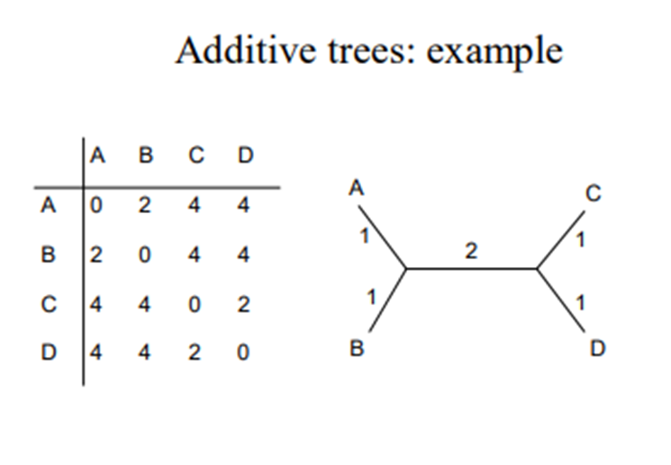
Additive matrix
A matrix is additive if it satisfies the four point condition.
A tree defines a tree metric, T[i,j]; i.e., the pairwise distances between all pairs of leaves.
All tree metrics are additive.
If a matrix, O[i,j], is additive
there exists a unique tree topology with branch lengths such that T[i,j] = O[i,j].
This tree can be obtained in polynomial time.
In real life, observed distance matrix, O[i,j] is never additive

Slide 17
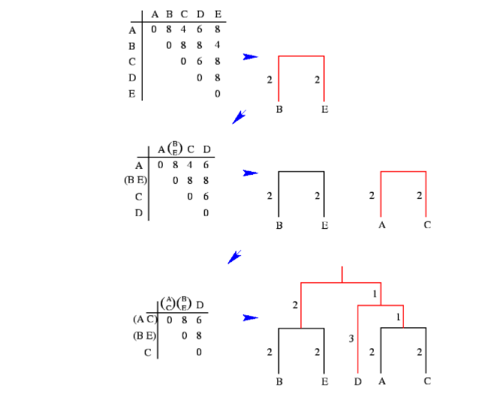
Ultrametric matrix
A matrix is ultrametric if it satisfies three point condition.
All ultrametric matrices fit rooted trees.
Not all rooted tree metrics are ultrametric.
An ultrametric tree
– satisfies the molecular clock hypothesis.
– All distances from the root to a leaf are the same.
– Its branch lengths are proportional to time.
Notes:
Most data is not really ultrametric.
If data are ultrametric, then strong evidence for molecular clock within that data, and that evolutionary tree is likely to be correct.
Un-ultrametric data sometimes can be fitted to “closest” ultrametric matrix nearby.

Slide 18
Ultrametric is additive
An Ultrametric set is also Additive
Additive matrix is not necessarily ultrametric
Figure4: Diagrammatic View of the Concept of Additive & Ultrametric Matrices

Slide 19
Ultrametricity VS Additivity

