Slide 2
About us
•
•
•
•
•
•
A 360 degree digital agency One Stop Shop
Highly experienced in servicing clients across ALL industry verticals. Penetrative and Strong Media buying and Procurements.
Young, passionate and motivated team
INNOVATIVE
At Digi Culture we just not
make paper planes, we make them fly.
EXPERIMENTAL
We believe that every strategy needs
testing, using out Digital tools, we make sure to deliver the best.
PERFECT
At Digi Culture we
love to deliver to our clients in a Perfect manner.

Slide 3
Few of our Clients

Slide 4
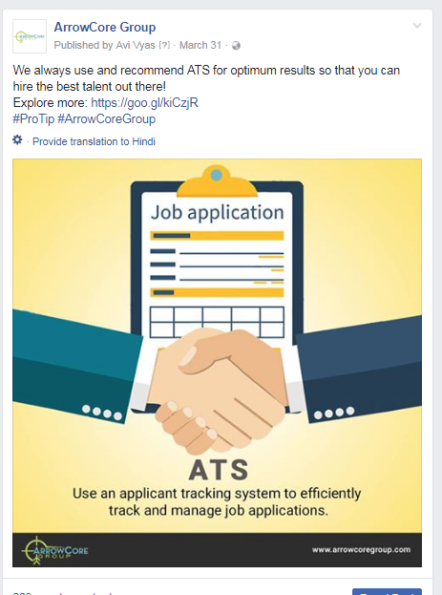
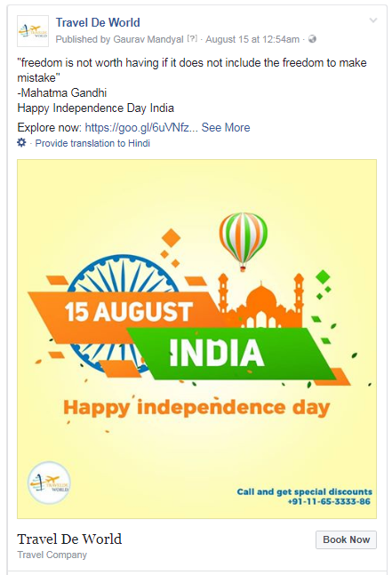
Some of our works

Slide 5
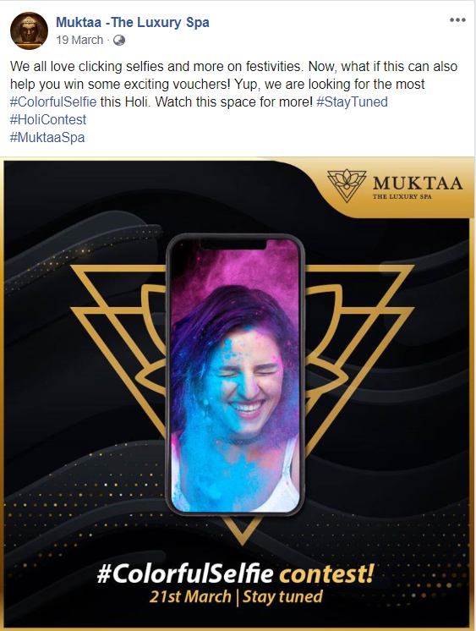
Some of our works

Slide 6
Why Digital?

Slide 7
Strengthen the Corporate Brand
The first and foremost reason would be to improve the overall branding of the brand.
Digital helps in creating a vivid picture of how the brand interaction point meets customers and product.

Slide 8
Creating a culture that people value
Digital space creates a culture that people value. Employee engagement rates can go up as a result of social impact.
Socially-enabled brand are better at retaining employees.
Stakeholders like partners and parents and even press and the public tends to trust brands with strong digital presence.

Slide 9
Build Lasting Business Relationships
Social space helps in building long-lasting business relationships.
Social will actually focus on lifetime value of your end customers.

Slide 10
Care About Your Environment
Integrating digital space with CSR activity empowers brands to create awareness at mass level.
Everybody love authentic stories that help common people and more the mass connect, more is the increase in brand value.

Slide 11
Crowd helps in making a better product
Digital media helps in involving crowd in developing the business.
Putting up a new service idea will gather numerous feedback online including that of customers, partners and even can attract investors and stakeholders.

Slide 12
Get Feedback Directly From Your Audience
Digital media can be very useful for optimizing or improving or even reshaping your product category by getting feedback directly from the customers.
It is fastest way of identifying any issue in the services that customers are facing.

Slide 13
Spot and Attract World Class Talent
Recruiters are going social these days. Digital technology and tools helps in sourcing the right talent from right medium.
By giving all the information, application facility online and social media integration, brand can attract the best talents and skip the hassle of offline application process.

Slide 14
Social Media Optimization

Slide 15
Social Media Usage in India
120.00%
100.00%
80.00%
60.00%
40.00%
20.00%
0.00%
Facebook
Youtube
linkedin
twitter
slideshare
flickr
blogs
other

Slide 16
Social Media Marketing Objectives
Provides the ability to quickly popularize your company’s Service Set and Promote ecommerce.
Very effective and cost efficient Digital media tool.
Social Media Optimization spotlights your business among Target markets.
Enhances traffic on Website. Hence, Support process of Search engine Optimization.
Supportive tool to capture feedback and testimonials. These aid in promoting online sales.
Online relationship & reputation Management.

Slide 17
Content Categorization
About
Company
Features
Generic &
Updates
About the brand
About the Group
About its CSR and Advisory
Company’s Sources
Its development process
About its products & services
Collaborations
Motivational & Inspirational Quotes
Trending topics
Any Cause driven posts
Humor
Festive Posts
Campaigns
Contests
Social Association
Latest News

Slide 18
Post Categorization
Simple text posts
Case Study
Awareness
Posts
Video Posts
Blogs
Fact based post
Infographics
Gif Posts
Series
List Posts

Slide 19
Social Media Marketing Platforms
Facebook
Twitter
LinkedIn
Youtube
Instagram

Slide 20
Workflow
Platform | Activities | Objective | Monthly posting
Facebook | Creating Content & Graphics Posting & Moderation Partner Video Content Moderation Response to Queries | Social Presence Engaging audience | As per the decided plan
Twitter | Creating & Maintaining Official Twitter Profile Reposting FB posts & Videos | Social Presence | As per the decided plan
Youtube | Creating & Maintaining Official YouTube Account Adding all available videos with full details | Social Presence Video Reach | As per the decided plan
LinkedIn | Maintaining company profile Inviting similar professional individuals Posting & Moderation | Brand Building | As per the decided plan
Blog | Sharing information about company’s work & profile Any other latest new or update related to organization | Providing information | As per the decided plan

Slide 21
Thank you

