Slide 2
ISLAMIA COLLEGE PESHWAR
Presented To: Ma’am AMBREEN AFTAB
Presented By: IMRANA ARIF
Subject: Teaching Method and Strategies
Session: 2017-19
Mirpur University of Science And Technology(MUST), Mirpur A.K Department of EDUCATION

Slide 3
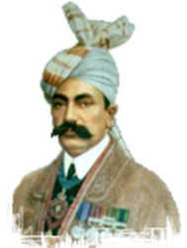
INTRODUCTION
The symbol of academic excellence in history.
The Sir Sayed and his sincere colleagues, founded Islamia College Peshawar in 1913.
spread over 300 acres of land
(District Charsadda).

Slide 4
INTRODUCTION
Quaid-e-Azam Muhammad Ali Jinnah visited this College in 1936, 1945 and 1948.
Quaid-e-Azam made the College one of the heirs of his property in 1939.
upgraded into Islamia College University in 2012 during the platinum jubilee celebration of the school

Slide 5
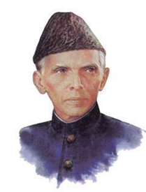
QUAID-E-AZAM WILL
... All my residuary estate including the corpus that may fall after the lapse of life interest or otherwise to be divided into three parts - and I bequeath one part to Aligarh University - one part to Islamia College Peshawar and one part to Sindh Madrassa of Karachi ...
Quaid-e-Azam s Will, Bombay, May 30, 1939

Slide 6
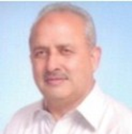
VICE CHANCELLOR
Prof. Dr. Habib Ahmad
July 28, 2016 – To - This Date

Slide 7
VISION
Provide opportunities to the settlers of N.W.F.P to realize their abilities and strength
Generate the hidden potentials into the all-round development of the students
students’ adaptabilities towards various positions in their practical life

Slide 8
FACULTIES
The Faculty of Arts & Languages
The Faculty of Basic & Social Sciences
The Faculty of Religious and Legal Studies
The Faculty of Natural Sciences
The Faculty of Technologies & Engineering Sciences

Slide 9
ACADAMIC CALENDER

Slide 10
EXAMINATION SYSTEM
It offers both semester and annual examination system
Semester system is used in the campus
Annual system is for affiliated colleges

Slide 11
ADDRES OF ISLAMIA COLLEGE
Email Address:
registrar@icp.edu.pk
Postal Address:
Islamia College Peshawar
Jamrod Road, University Campus
Peshawar, Khyber Pakhtunkhwa, Pakistan
25120

Slide 12
LOCATION MAP

Slide 13
THANKS FOR YOUR ATTENSHION!
HOPE YOU SLPET COMFORTABLY!

