Slide 1
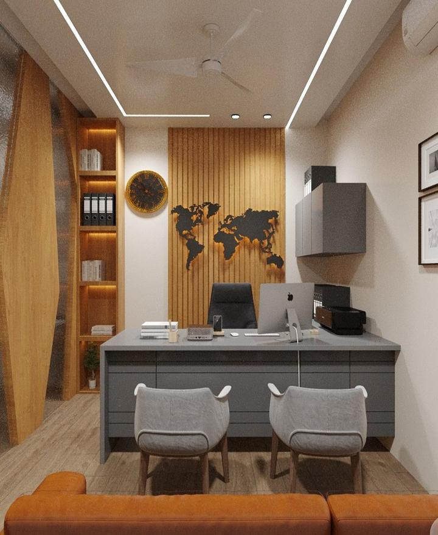
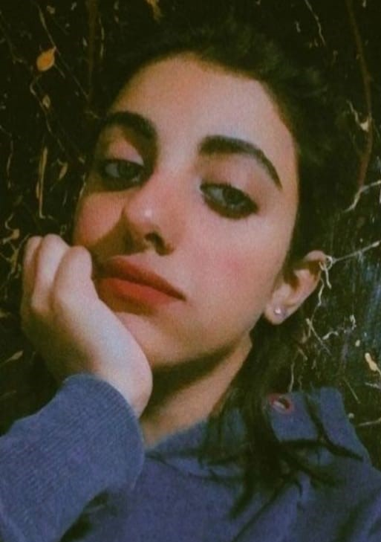
I N T E R I O R R E N D E R S
BY AR. FATIMA TAHSEEN
ABOUT ME:
I AM AN ARCHITECT WHO FOLLOW DESIGN LINES, BEST FOR ENVIRONMENT. MY MAIN FOCUS IS TO CREATE DESIGNS
AND BUILDINGS WHICH ARE BENEFICIAL FOR NOT ONLY USER BUT ALSO IS HELPFUL IN MAINTAINING HEALTHY ENVIRONMENT FOR FUTURE NEEDS.

Slide 2
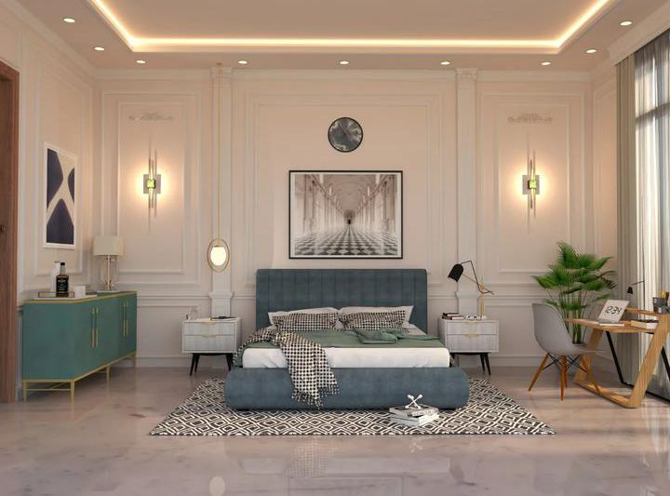

Slide 3
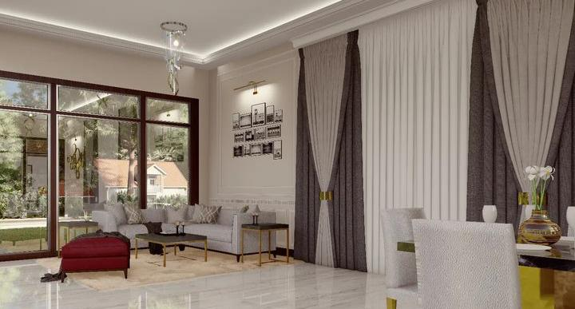

Slide 4
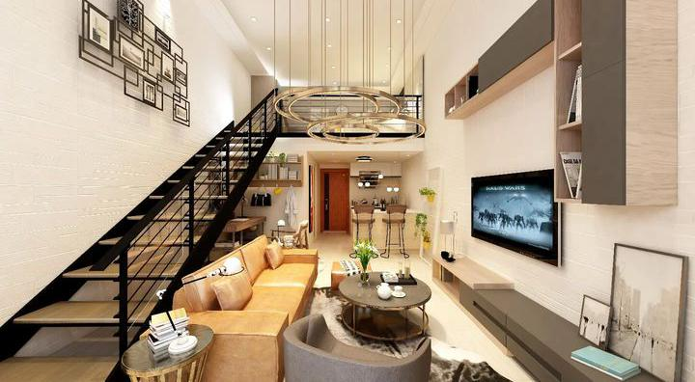

Slide 5
THANK YOU

