Slide 1
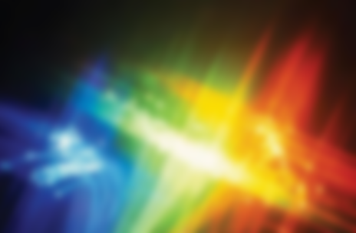
SPECTROPHOTOMETRY
PRESENTED BY
AYESHA
AFIFA
AHSAN

Slide 2
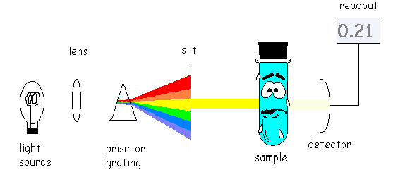
SPECTRUM- light spectrum
PHOTO-LIGHT- energy wavelength
METRY- measurement
Spectrophotometry is a technique used to measure the concentration of solutes in solution by measuring the amount of light that is absorbed by the solution by spectrophotometer

Slide 3
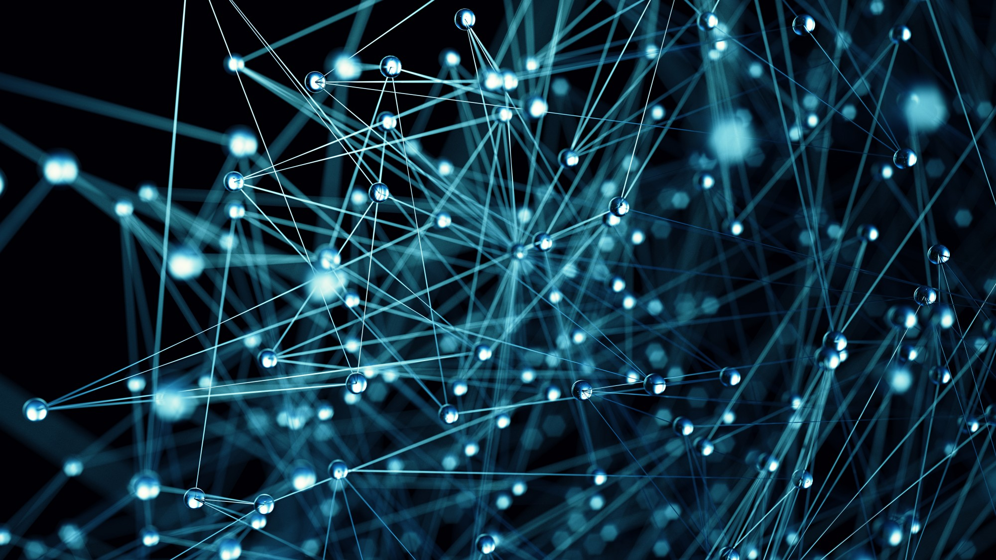
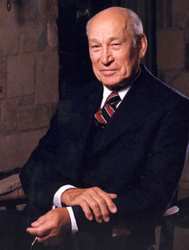
Background
Measurement technique depend on optical properties of material (absorbance, transmittance, spectral reflectance etc.)
Spectrophotometer – identify/quantify these physical properties.
Nature of interaction = physical property of material
Spectrometer was invented by 1940 by Arnold J Beckman
Quantitative measurement of interaction of ultraviolet, visible and infrared radiations- with material.
Notes:
Transparent, opaque, smooth rough, pure or contaminated, thin thick.

Slide 4
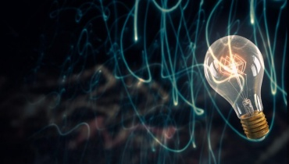
Radiant Energy
The electromagnetic spectrum include gamma ray, X-ray, ultraviolet (UV), visible, infrared (IR), microwave and radio-wave radiation.
Light and other forms of radiant energy have a dual nature (wave and particle)
It takes numerous forms known as electromagnetic spectrum.
Electromagnetic radiation is a type of energy that is transmitted through space as a transverse wave at enormous velocity.

Slide 5
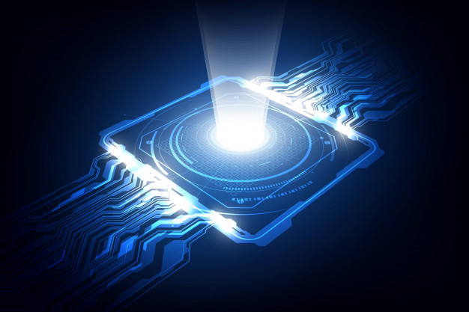
Light
1- Wave Properties
or in terms of the frequency(ν),
the number of oscillation of the field per second.
1- Wave Properties
The wave is described either in terms of its wavelength (λ),
the distance between successive maxima or minima of a wav(nm),
The velocity of light, c, is given by the equation
C= ν λ

Slide 6
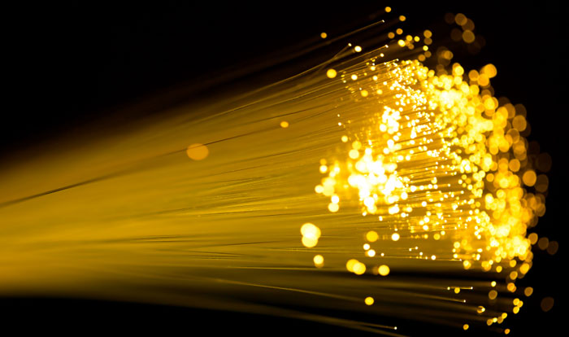
2- Particle Properties
Energy is inversely proportional to wavelength
2- Particle Properties
h = Planck’s constant (6.626 x 10⁻³⁴ J s)
ν = frequency of the radiation (most common units = cm⁻¹
2- Particle Properties
The energy E of photon depends upon the frequency of the radiation
E = hν
2- Particle Properties
Electromagnetic radiation of light can be viewed as a stream of discrete wave packets of distinct particles called photons.

Slide 7
The electromagnetic spectrum
The most analytically useful region is from 200 to 380 nm, called the near- ultraviolet region or quartz UV region
The near-infrared (IR) region extends from about 0.80μm to 2.5 μm
The far-infrared (IR) region extends from about 2.5μm to 16 μm
The infrared (IR) region extends from about 0.78μm to 300 μm
The visible (VIS) region extends from about 380 to 780nm
The ultraviolet region extends from about 10 to 380 nm

Slide 8
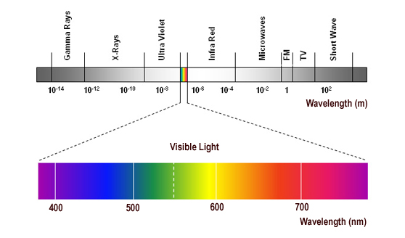
Regions of Electromagnetic Spectrum-the “colour” of light

Slide 9
The absorption process How does matter absorb radiation
When polychromatic light (white light), which contains the whole spectrum of wavelengths in visible region, is passed though an object will absorb certain of the wavelengths, leaving the unabsorbed wavelengths to be transmitted. These residual transmitted wavelengths will be seen as a color. This color is complementary to the absorbed colors.
Absorption is a process in which chemical species (atom, ion or molecule) in a transparent medium selectively attenuate certain frequencies of EMR.
The excited state is a transition one and the species soon looses the energy it gained and returns to its ground state by relaxation process either as heat of collision or sometimes emits radiation of specific wavelength.
At room temperature most substance are in their lowest energy or ground state. When an atom, molecule or ion absorbs EMR it is promoted to higher energy states or excited states.
Absorption spectrum is a plot of the amount of light absorbed by a sample as a function of wavelength.

Slide 10
When a molecule interacts with photons of UV or VIS radiation excitation of electrons takes place to higher electronic energy level at any of its vibrational level.
If large amount of energy is absorbed by certain substance, bonds may be ruptured and new compounds are formed photolysis.
Ultraviolet and visible radiations have sufficient energy to cause transitions of the outermost or valence electrons.
Eex-Eg= hν of the photon absorbed.

Slide 11
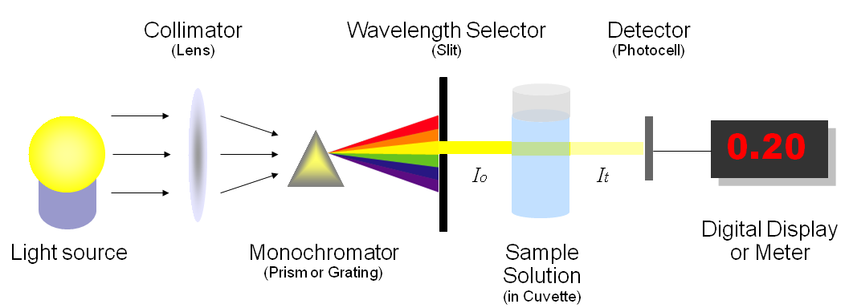
Principle
It is based on spectra and the belief that each chemical element has its own spectrum.
schematic diagram of a single-beam UV-Vis. spectrophotometer

Slide 12
Beer’s Law
The relation may be used to determine the concentration of a chemical species in a solution using a colorimeter or spectrophotometer.
The law states the concentration of a chemical is directly proportional to the absorbance of a solution.
The relation is most often used in UV-visible absorption spectroscopy

Slide 13
LAMBERT LAW
Lambert's law stated that the loss of light intensity when it propagates in a medium is directly proportional to intensity and path length

Slide 14
ε : is molar absorptivity and it is unique for a given compound ( L.mol⁻¹. cm⁻¹)
b : is path length of light through solution(cm)
c : absorbed molecular concentration (M)

Slide 15
Absorbance concentration
0 | 0
0.161 | 1
0.332 | 2
0.493 | 3
0.656 | 4
0.806 | 5
1.191 | 7.5
1.554 | 10

Slide 16
Deviations from Beer’s law
At ↑ concentrations
At ↓ concentrations

Slide 17
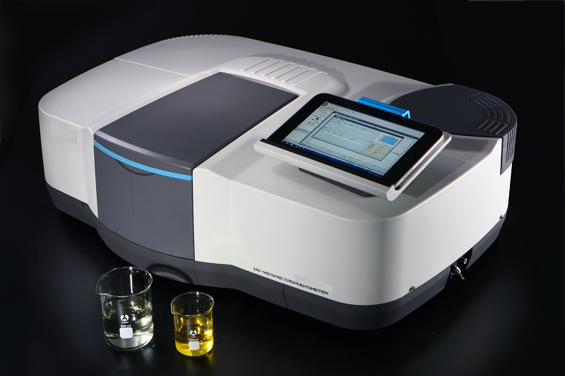
Instrument
Components
Light source
Wavelength selector (Dispersion devices)
Absorption cells (sample containers)
Detectors
Display devices
Notes:
Spectrophotometer measures the amount of light absorbed by the sample.

Slide 18
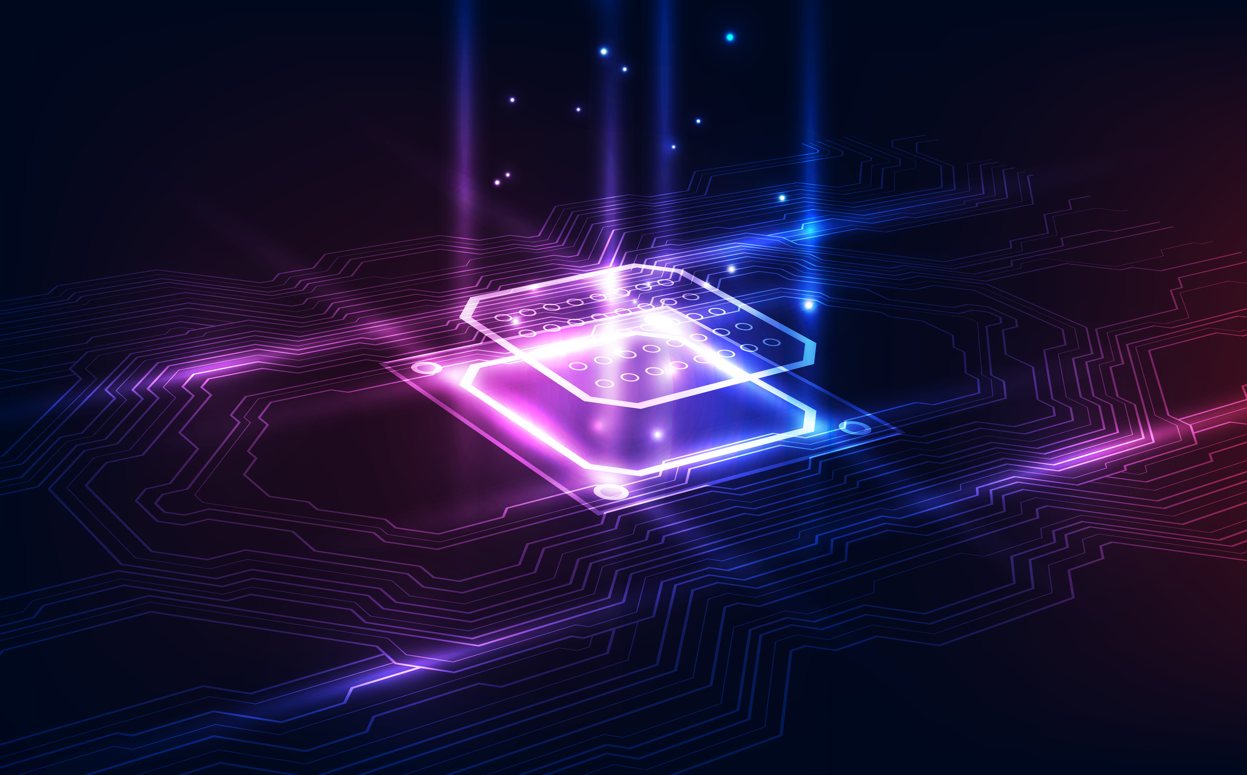
Light Source
Provide sufficient amount of light
Tungsten lamp
Hydrogen lamp
Xenon lamp

Slide 19
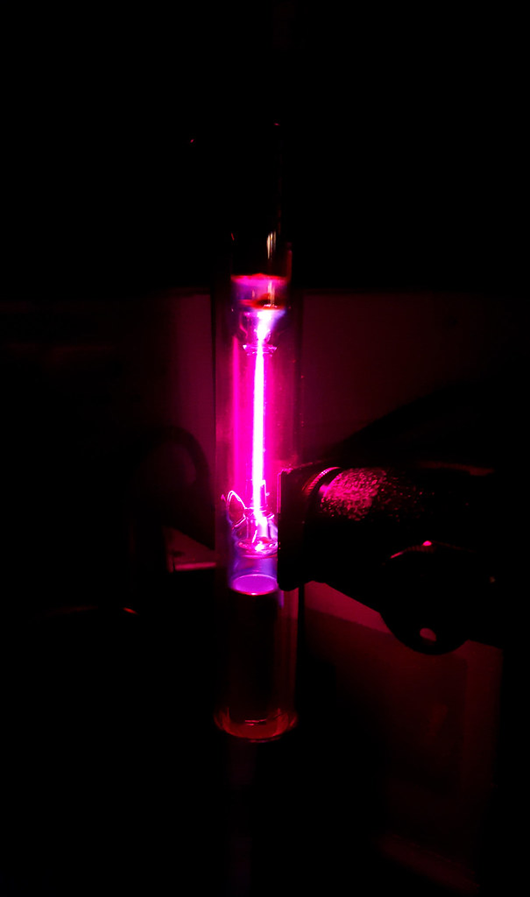
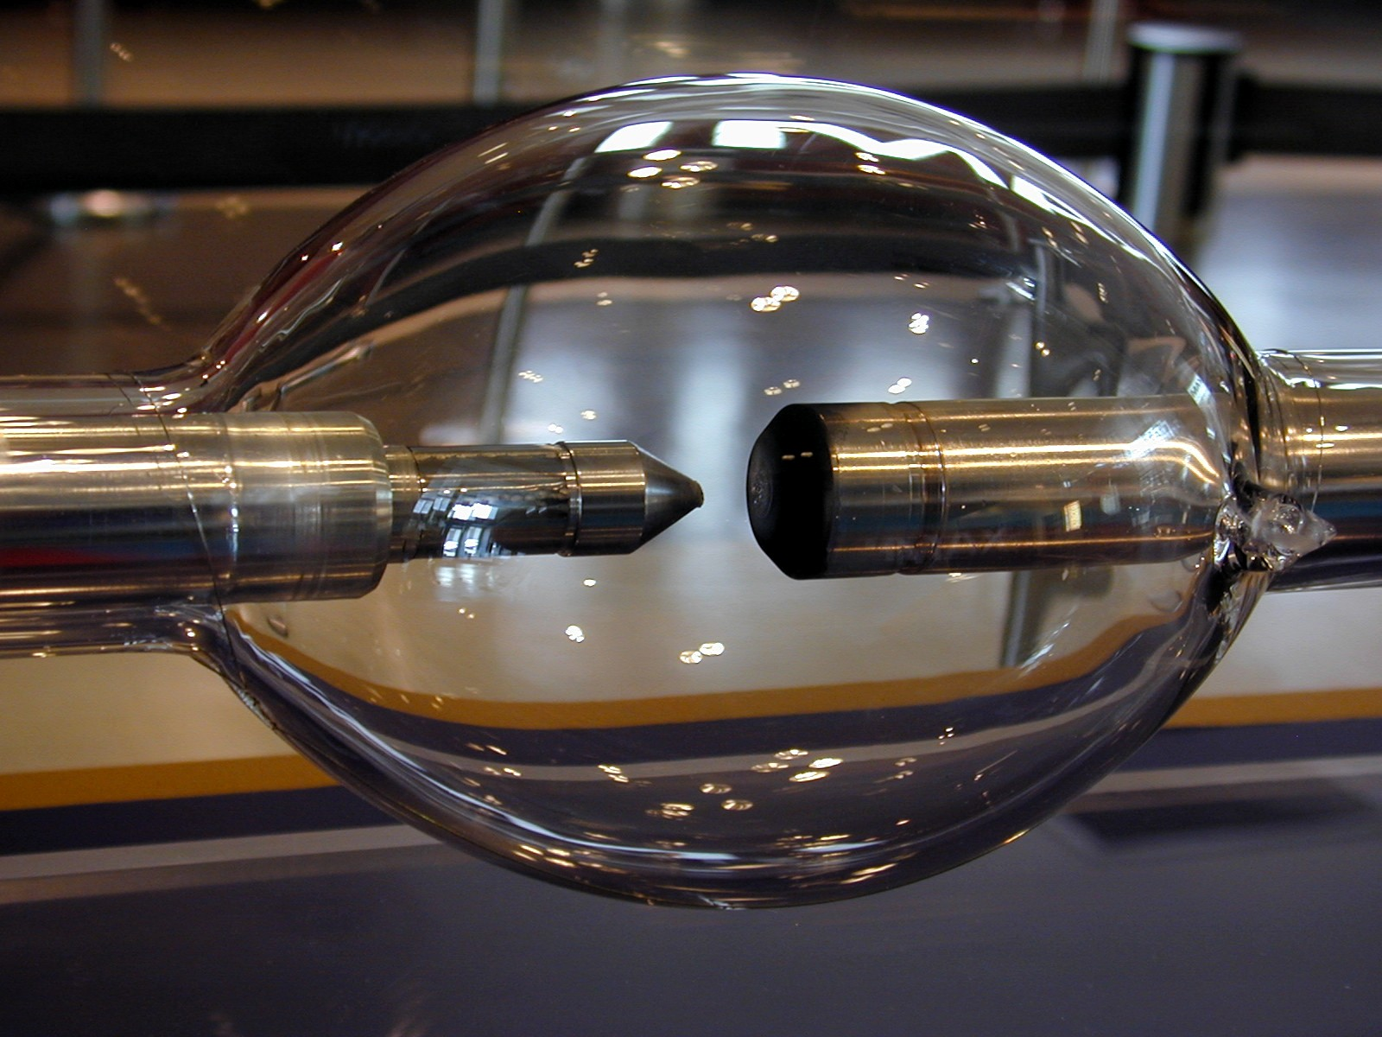
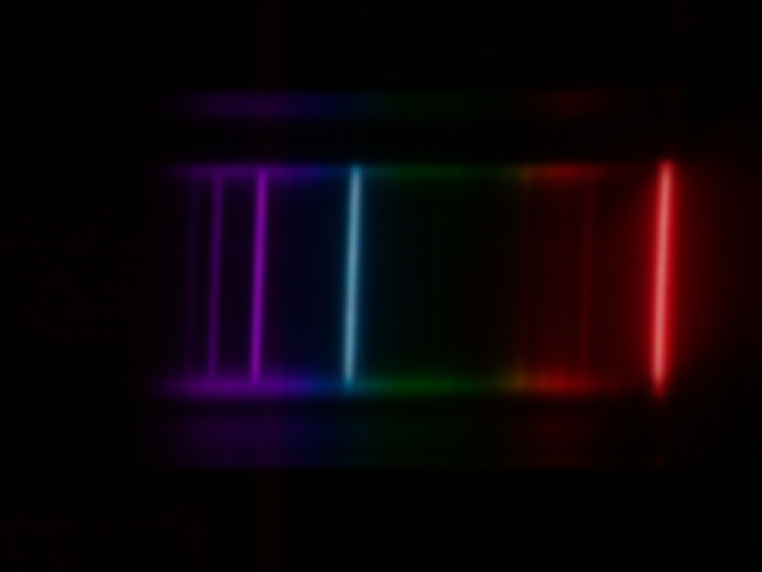
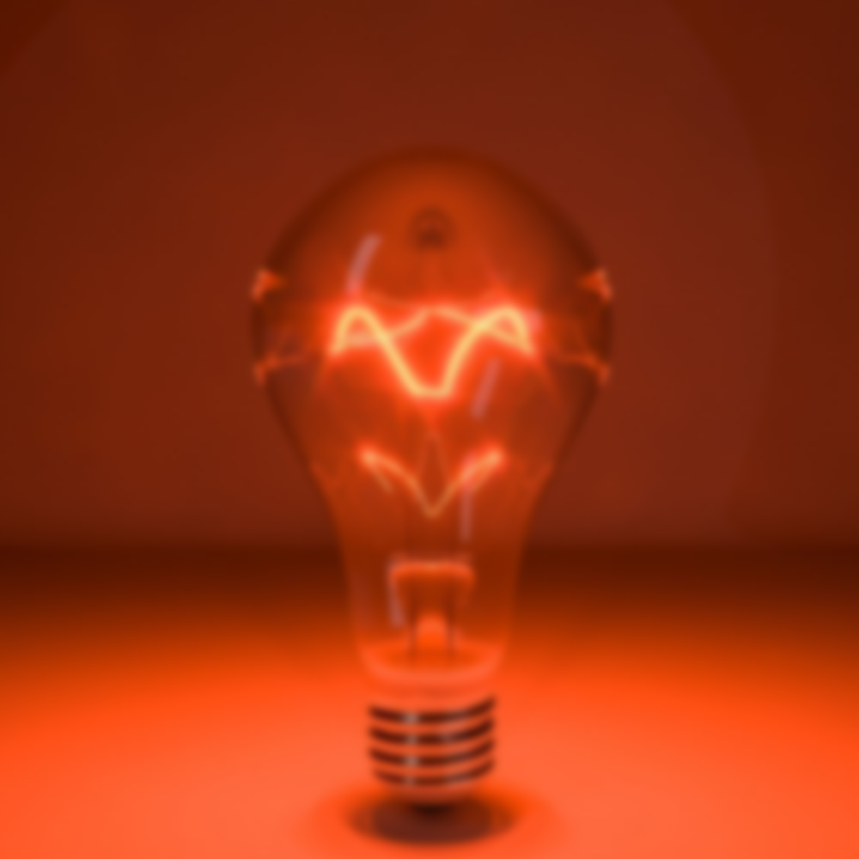
Tungsten Lamp
Xenon lamps
Hydrogen lamps
Most commonly used
Range about 330 to 900 nm
Has long life about 1200h
For ultraviolet regions
Range 200 to 450 nm
Long life 500h
Generate both continuous and discontinuous spectra
Range between 190 nm to 1000nm
Do not heat up the instrument
Emit both UV and visible light
Long life

Slide 20
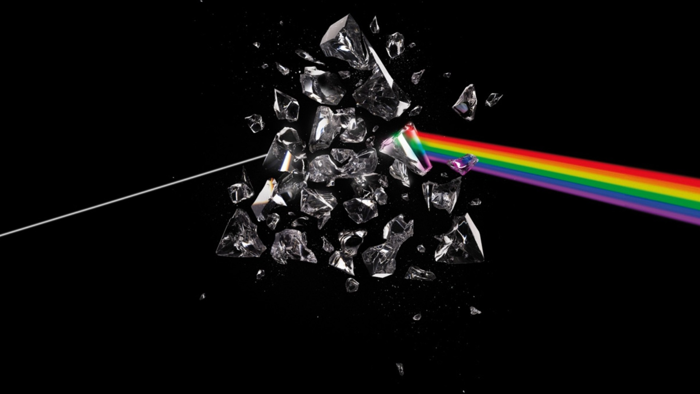
Dispersion devices
Types of devices
Prism
Filters
Diffraction Grating
Cause different wavelengths of light to disperse at different angles.

Slide 21
Prism
Used to isolate different wavelengths
Made up of glass or quartz

Slide 22
Filters
Filters separate different parts of electromagnetic spectrum by absorbing or reflecting certain wavelengths and transmitting other.
Green , red filters
Absorption filters are glass substrates containing absorbing specie

Slide 23
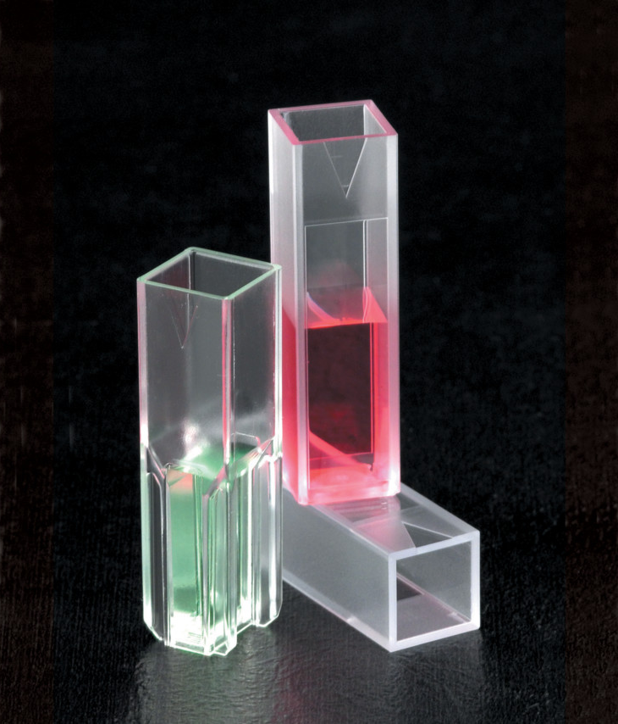
Absorption cells
Cuvette is a kind of cell sealed at one end made of plastic, glass or optical grade quartz designed to hold sample

Slide 24
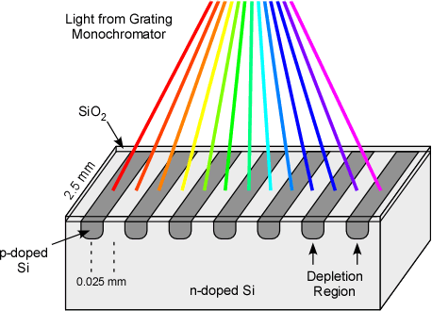
Detectors
Produce current which is proportional to intensity of light striking
Any photosensitive device can be used
Photocell and phototube

Slide 25
Display devices
Data from detector is displayed by readout device like analog meter, light beam refracted on scale or liquid crystal display (LCD).
Output can also be transmitted to computer.

Slide 26
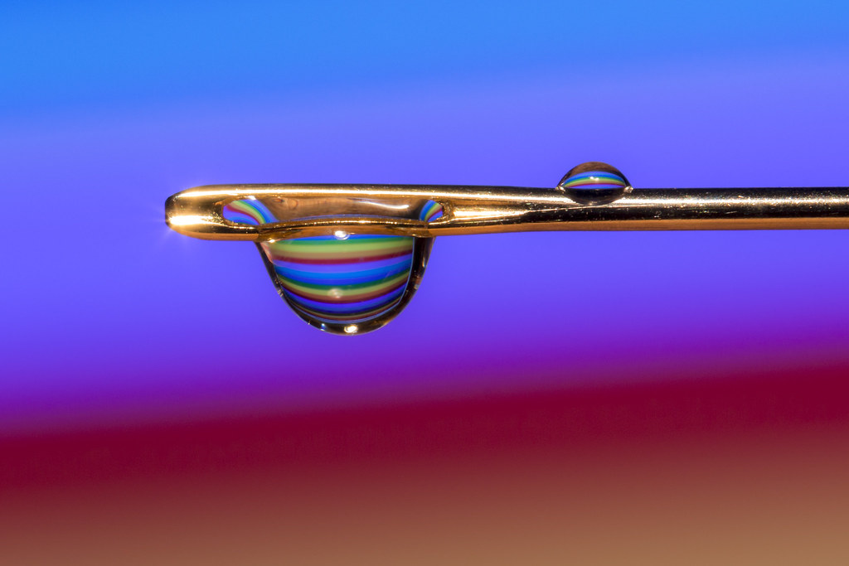
Types of spectrophotometer
Single beam
Double beam
Split beam

Slide 27
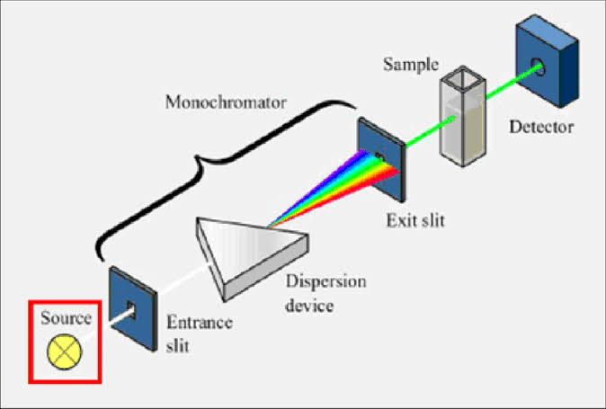
Single beam
First invented
All the light passes through sample
Cheaper
Less complicated

Slide 28
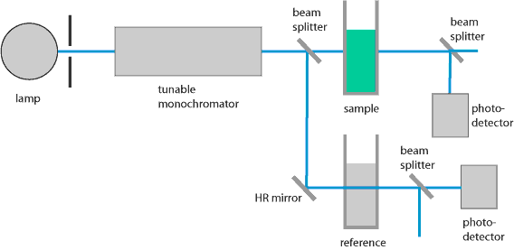
Double beam
Compares the light intensity between two paths, one containing reference sample, other containing test sample
Measurements are easier and stable
But higher cost
Complex optics

Slide 29
Applications

Slide 30
Uses of spectrophotometry
Identify organic compounds by determining the absorption maximum
Used for color determination within spectral range
To determine the absorbance and or transmission of characteristic wavelength of light by chemical specie in solution

